Slide 1
Comprehensive training of system hardware
Lecturer：Feng Liu
514045623@qq.com
Stony Brook Institute at Anhui University

Slide 2
QQ group：1059029595
Online learning resources， introduce first-class MOOC courses：
https://www.icourse163.org/learn/HUST-1205809816
Togo platform (verification circuit):
https://www.educoder.net/ ：Check and provide template files
Class code invitation code
Monday afternoon：QULD7J TA:陈泳铭 Monday evening:OK4HN9 TA:闫一鸣
Tuesday afternoon:RHMP7L TA:王靖铭 Tuesday evening：M2DQN5 TA:黄睿
B Station resources：https://space.bilibili.com/1166580004/video

Slide 3
Smart teaching resources：https://ahu.yuketang.cn/
Student pre class and in class tests
Provide various teaching resources
AI intelligent teaching, 24-hour learning companion
Knowledge Graph

Slide 4
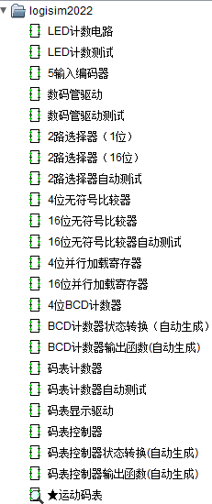
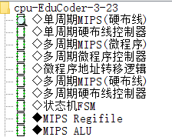
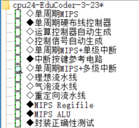
MOOC“Computer Hardware System Design”
一、Basic Experiment of Digital Logic
（1）2.1 Combinational logic circuit design
（2）2.2 Sequential Logic Circuit Design
（3）2.3 Design of small digital system (Sports watch)
二、 MIPS CPU design
（1）6.1 Single cycle MIPS architecture
（2）6.2 Multi cycle MIPS architecture
（3）6.3 Single cycle MIPS CPU design (8 instructions)
（4）6.4 Multi cycle MIPS CPU (Microprogram Controller) Design
（5）6.5 Multi cycle MIPS CPU (Hardwired Controller) Design
（6）6.6 Single cycle MIPS CPU design (24 instructions)
https://www.icourse163.org/course/HUST-1205809816
Circuit design：
Sports watch
Single cycle MIPS CPU (8 instructions)
Multi cycle MIPS CPU (Microprogram Controller, 8 instructions)
Multi cycle MIPS CPU (Hardwired Controller, 8+3instructions)
Single cycle MIPS CPU (24 instructions)

Slide 5
Comprehensive training task of system hardware：
1、Learn MIPS machine instruction Set
2、Design 4 CPU with different structures Multi cycle MIPS CPU (Microprogram Controller, 8 instructions)
Multi cycle MIPS CPU (Hardwired Controller, 8 instructions)
Multi cycle MIPS CPU (Pure Hardwired Controller, 8+3instructions)
Single cycle MIPS CPU(Hardwired Controller, 24 instructions)
3、Each design is scheduled to be completed in three weeks：
In the first week, the teacher assigned the task, and the students learned by themselves in MOOC, designed the circuit, and went through the test on Touge Platform. submitted the draft version experiment report before the second week class.
In the second week, the teacher explained the principle, and the students improved the circuit, and went through the test on Touge Platform, submitted the the final version experiment report.
In the third week, the teacher checked the design.
The number of instructions can be expanded.
we should have a thorough understanding of the theoretical and experimental knowledge of hardware courses such as digital circuit, assembly language, computer composition principle and system structure.

Slide 7
Score calculation method
Score=pre class Preview * 0.1+Touge Platform test * 0.1+in class circuit check * 0.5+After class experimental materials * 0.2+oral defense scores * 0.1
（1）Encourage to have your own ideas to do experiments, such as increasing the number of different instructions, changing the number of microprograms and the content of control fields, preparing complex programs, doing interrupt circuits, etc., especially HDL+FPGA design, which can effectively improve the final score.
（2）In the last class, we will make a defense, focusing on what tasks and experiences you have done. If you complete optional task, you can explain the working principle. Each person should report for no more than 5 minutes (please control the time, and the error should not exceed 1 minute), and answer questions for 2 minutes (all students are allowed to ask questions)。

Slide 8
Weeks | task
Week 2 | Publish the design task of project 1. https://www.bilibili.com/video/BV19F411x7Zh
Week 3 (teaching) | In class: teacher explains the difficulties and key points of project 1. After class: the students improve project 1;
Week 4 (inspection) | In class: teacher checks the implementation of project 1; Publish the design task of project 2. After class: students improve project 1, and the final version file of project 1 shall be submitted to the group leader in two days; (group leader shall check the integrity and naming rules ,package them to the teacher's mailbox before the deadline) After class: students learn project 2 by MOOC and start design;
Week 5 (teaching) | In class: teacher explains the difficulties and key points of project 2. After class: the students improve project 2;
Week 6 (inspection) | In class: teacher checks the implementation of project 2; Publish the design task of project 3. After class: students improve project 2, and the final version file of project 2 shall be submitted to the group leader in two days; (group leader shall check the integrity and naming rules ,package them to the teacher's mailbox before the deadline) After class: students learn project 3 by MOOC and start design;
Week 7-12 | completion of the design of project 3 and project 5
Week 13 | In class: Course summary and defense

Slide 9
The following files are submitted for each project:
（1）R3211XXXX张三yymmdd_circuit.CIRC；
（2）R3211XXXX张三yymmdd _report.PDF；
（3）All the.XLSX files that help create functions. R3211XXXX张三yymmdd _i. XLSX.
（4）Assemble source program files (. ASM) and machine language program files (. HEX).
R3211XXXX张三yymmdd _i.ASM, EXXXXXX张三yymmdd _i.HEX.
（5）R3211XXXX张三yymmdd _summary.PPT；PPT defense for the last class.
remarks: （1）The above files are compressed into R3211XXXX张三yymmdd.RAR. Five project compressed files 1-4；
（2）Submit the draft version file and went through the test on Touge Platform before the class in teaching week (Evening before class);
（3）Submit the final version file and went through the test on Touge Platform after the inspection week (two days after class);
shall be packaged and
submitted in each project
submit in last week

Slide 10
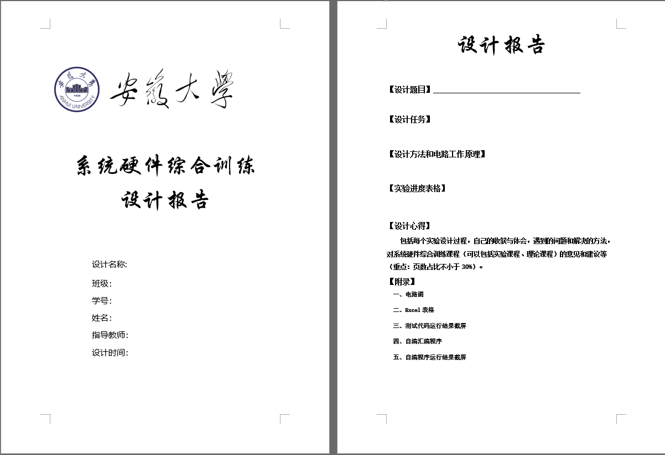
设计报告的模板（PDF文件）
1、封面
封面包括设计题目、班级、姓名、学号以及完成日期等信息。
2、正文
（1）设计题目
（2）设计内容
（2）设计方法和电路工作原理
（3）设计过程
（4）设计心得（包括每个项目自己的收获与体会；填写项目进度表；遇到的问题和解决的方法；对项目课程和理论课程的意见和建议等）——重点！
3．附录
（1）每个电路图
（2）每个自动生成表达式的excel表格
（3）自己编写的代码及二进制机器指令

Slide 11
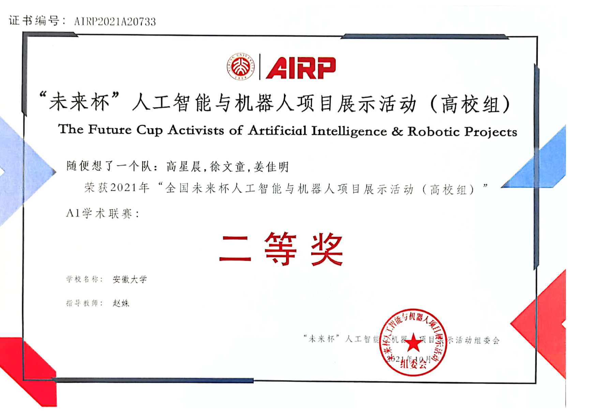
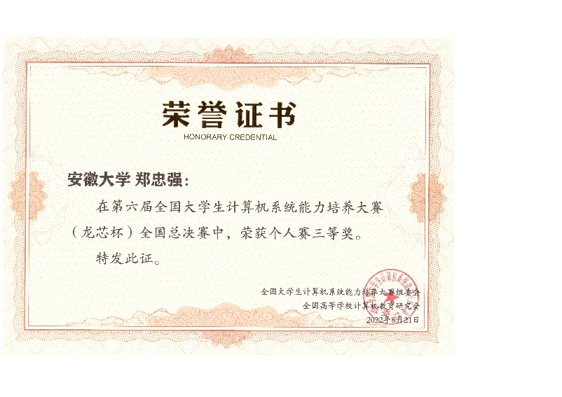
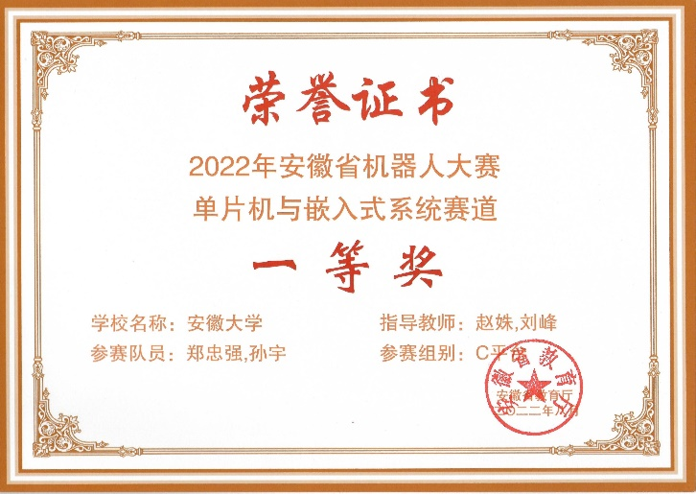
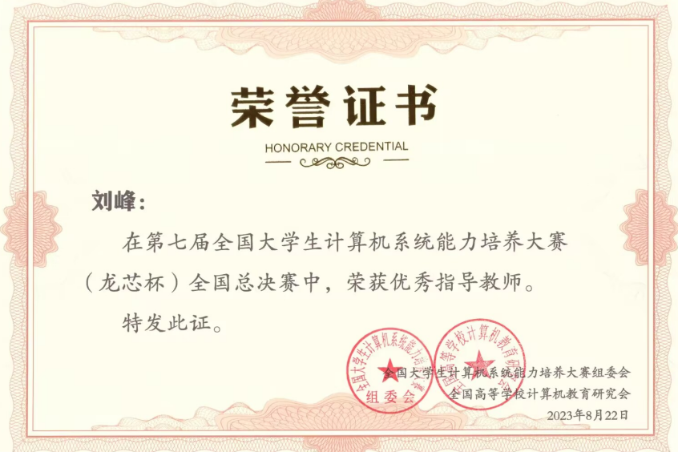
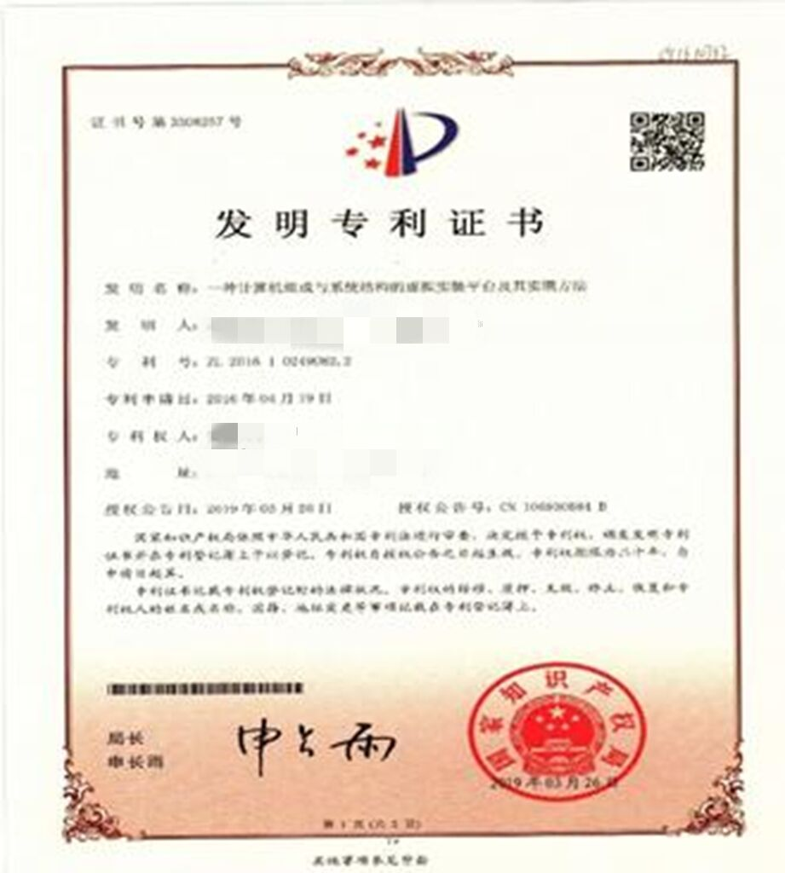
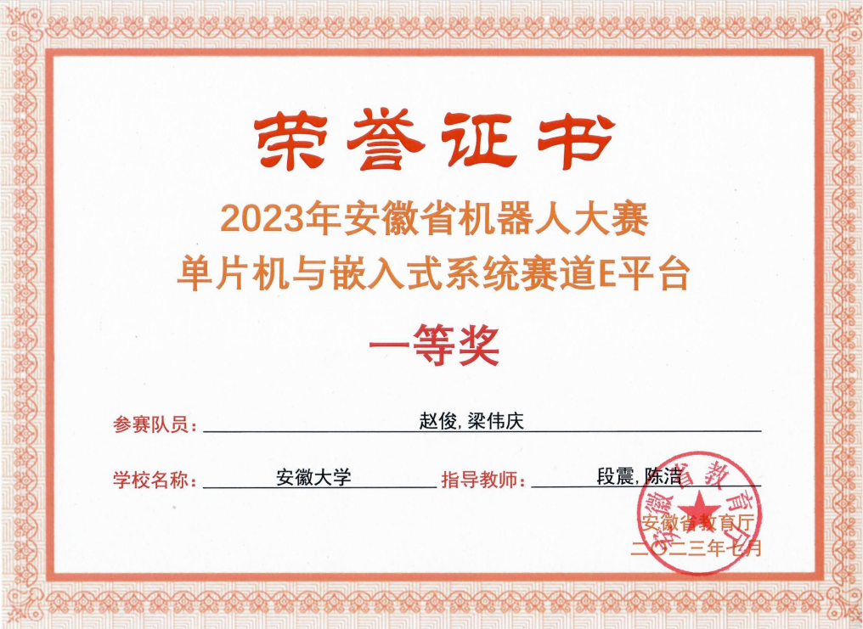

Excellent achievements
Student awards
In 2023, won the third prize of the 7th National College Students Computer System Ability Training
In 2023, we won two first prize (No.1，2，3) and three second prizes in the provincial chip design competition
In 2022, we won the second prize of "Future Cup" artificial intelligence and robot
In 2022, won the third prize of the 6th National College Students Computer System Ability Training
In 2022, we won one first prize (No.1) and two second prizes in the provincial chip design competition
In 2021, we won one first prize (No.1) and one third prize in the provincial chip design competition
Students are granted patents
In 2019,Approved invention patent “***Computer composition and architecture***”
Notes:
串词加上学生的素质提升，包括参赛人数多，参赛种类多，高年级带低年级这样的。

